Slide 1
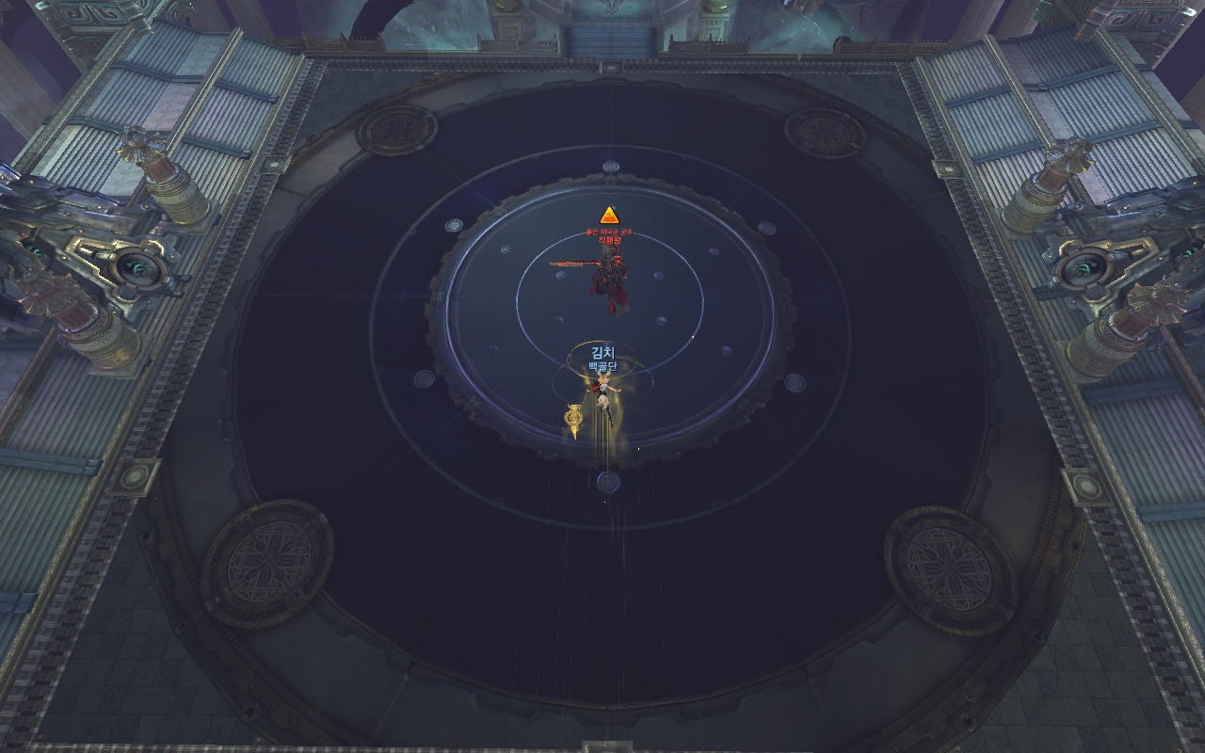
3,4P
Tank
1,2P
1. Starting State: Each Party and the Tank positions like the position above

Slide 2
1,2P
Tank
3,4P
2. After 1:20: The lasers will make you move clockwise, and will be positioned like above (180 degree spin)
Then, the Adds will appear, and the 1,2 party will kill the add on the upper map, and 3,4 the lower map.

Slide 3
Add
1,2P
Tank
3,4P
ADD
3. (assuming the adds appear at 11, 5 o’clock, this is random like before 35%)
After the adds appear, the Steel-balls will try to explode and they will be CC-able after few seconds. Every one of them must be CCd or else it will give a AoE Rupture debuff in the whole map.
(이때 ＂본인 쫄 반대방향＂은 예를들어 본인이 1,2파티라 아랫쪽쫄 담당인데 5시에 쫄이 떴으면, 7시로 이동하고 7시에 쫄생성이면 5시로 이동 윗쪽쫄도 마찬가지
또, 소환사의 경우 근거리쫄이 끌어당겨 그로기쓰는 스킬로 인해 합격기 방해될 수 있으므로 반드시 폭탄설치 스킬로 끊을것

Slide 4
1,2P
Tank
3,4P
4. If every Steel-ball is CCd, the lasers will reform and change shapes like above
If the adds are still there they must be killed, and then do damage to the boss afterwards.
During this, each party must get ready for the next upper/lower add like before

Slide 5
1,2P
Tank
3,4P
5. During the hexagon lasers, it is easy to do DPS so doing so is required.
Also, people who died outside the lasers is easy to revive so SUMs must do so.

Slide 6
폰드
1,2P
전발
린트
염인
Tank
댕청
눈맘
자희
3,4P
6. 2:40: The 2nd Adds appear, but the people who take care of the Breakdown AoE can’t CC the steel balls this time because it’s too far, someone else has to do it for them.
인포

Slide 7
1,2P
Tank
3,4P
7. After that, it is basically the same as the initial state. Repeat this

